Slide 1
How to: Create a Realm account Create a pledge Set up automatic giving
920.733.7393
info@firstcongoappleton.org
Office Hours: Monday - Friday, 9:00 AM - 3:00 PM

Slide 2
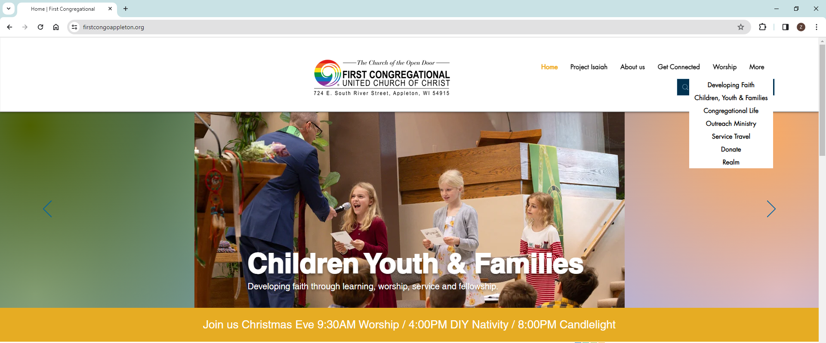
How to create a Realm Account
Go to our main website
https://www.firstcongoappleton.org/
Mouse over “More,” and click “Realm”

Slide 3
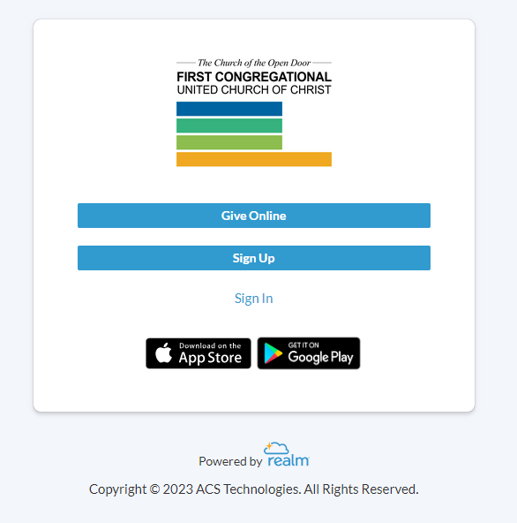
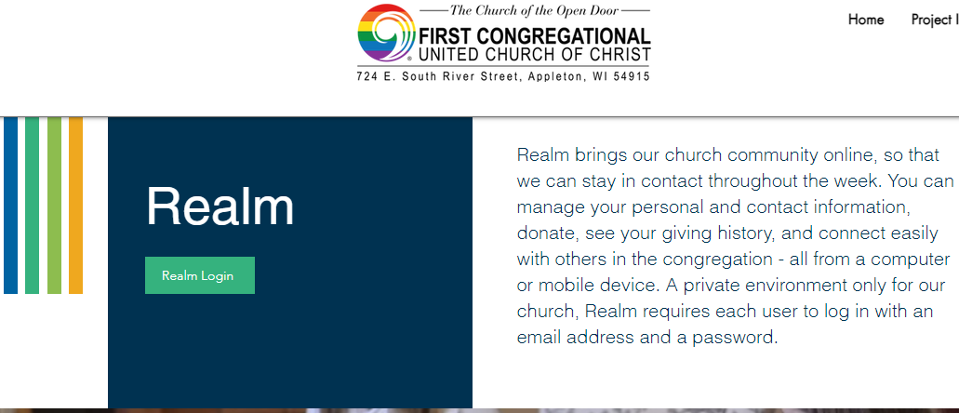
How to create a Realm Account
Click “Sign Up”
https://onrealm.org/firstcongoappleton/Account/Start
Click “Realm Login”

Slide 4
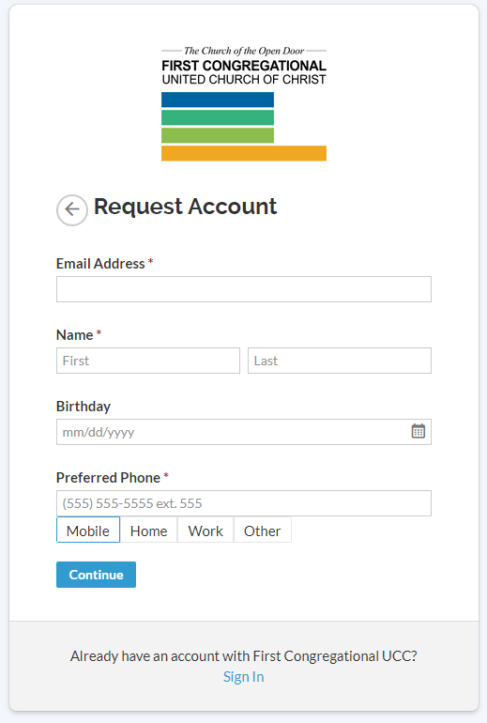
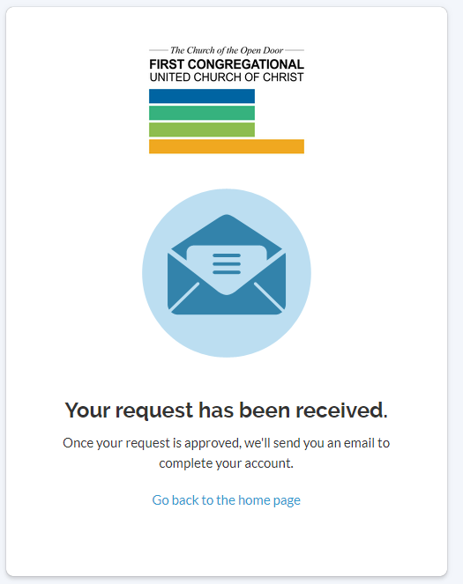
How to create a Realm Account
Fill out your information, then “continue”
Wait for FCUCC Staff to approve your account request

Slide 5
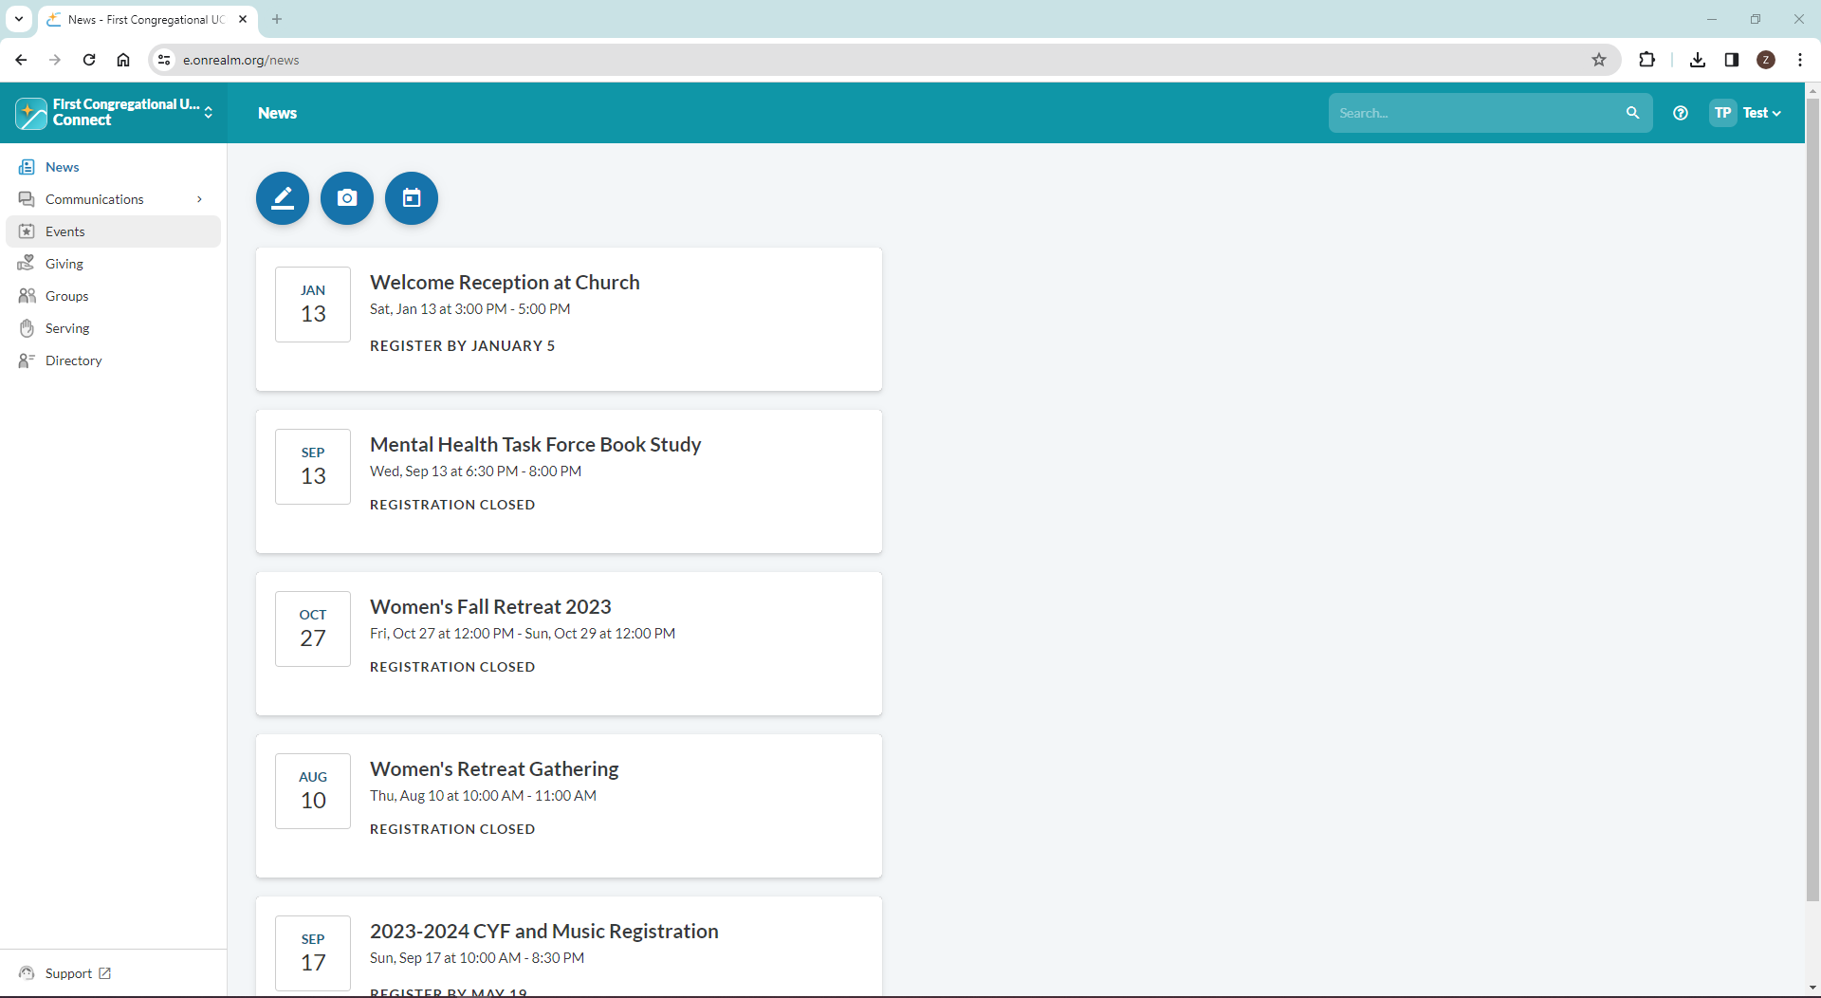
Finishing up your account.
Once your account has been approved, you will receive a link to finish your sign up. Once you are finished, log back in and go to your main page in order to start the process of setting up your pledge.
This is what your page should look like.

Slide 6
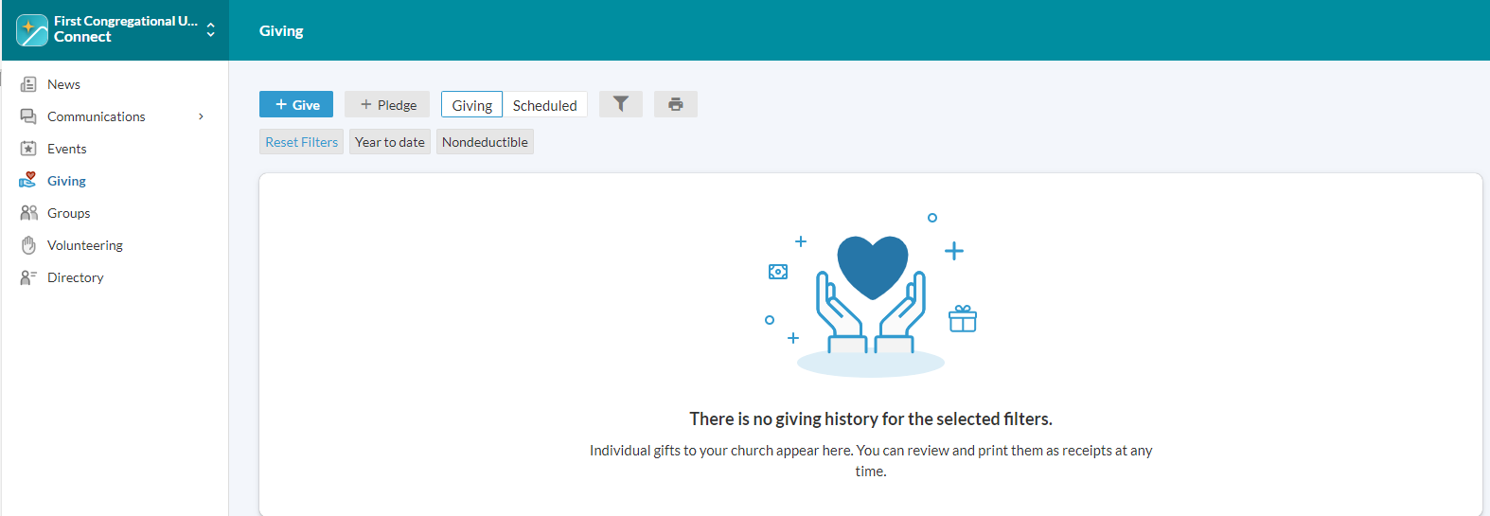
How to create a pledge
Log in
Click “Giving” on left hand side
Click “+ Pledge”

Slide 7
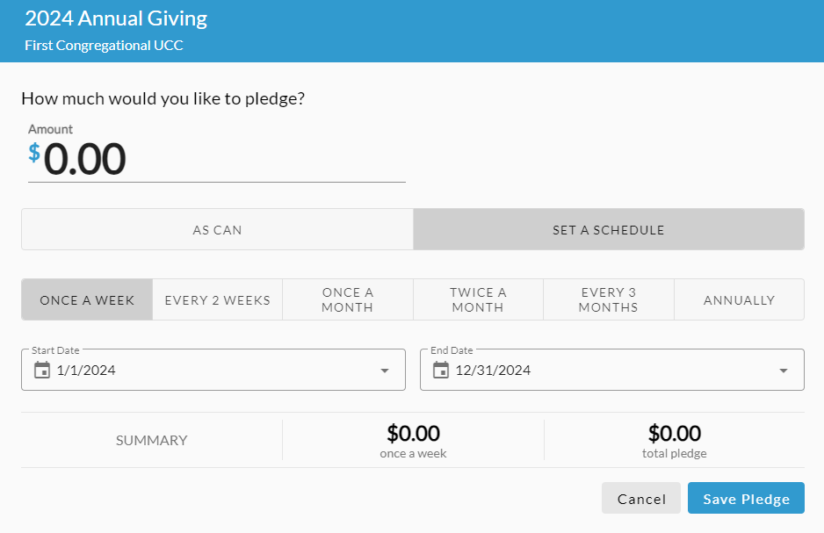
How to create a pledge
Select the year you are pledging for
Fill out your desired pledge information – “As Can” tab will not prompt you to set a schedule. Click “Save Pledge.”

Slide 8
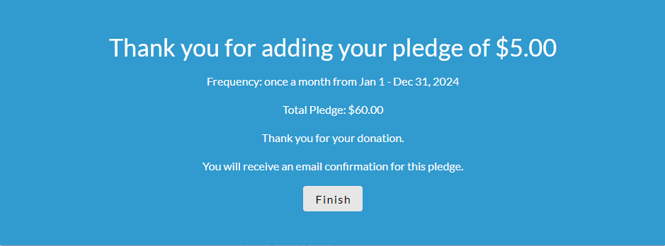
How to create a pledge
Your pledge is now created! Keep reading if you would like to set up automatic payments

Slide 9
How to set up automatic giving
Log in
Click “Giving” on left hand side
Click “+ Give”

Slide 10
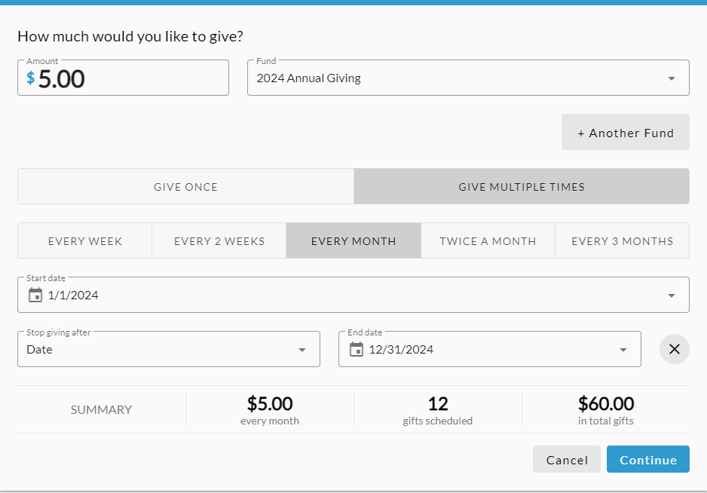
How to set up automatic giving
With an end date
Continuous Autogiving (will continue until stopped)
Fill out your information
Click “Continue”
Click “+End,” Fill out your information
Click “Continue”

Slide 11
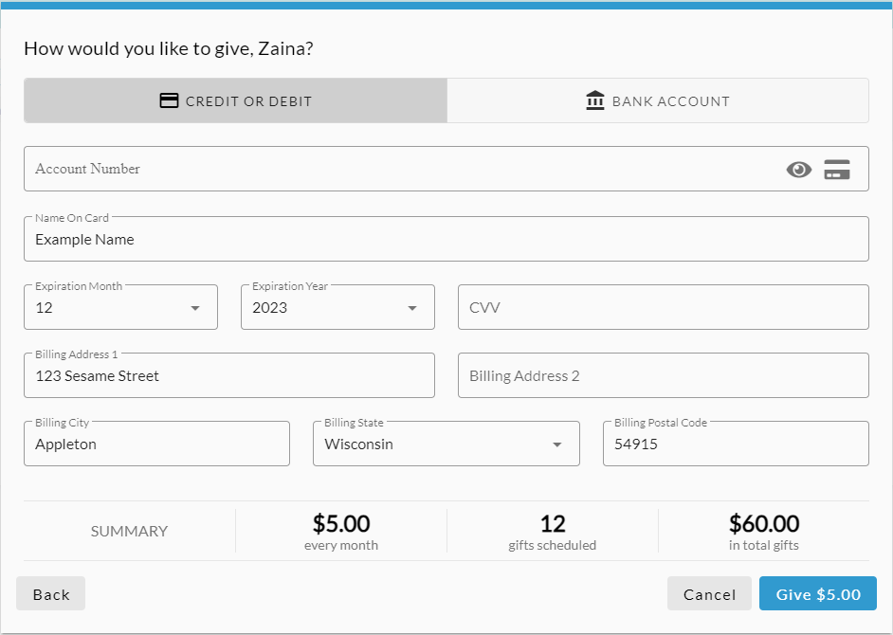
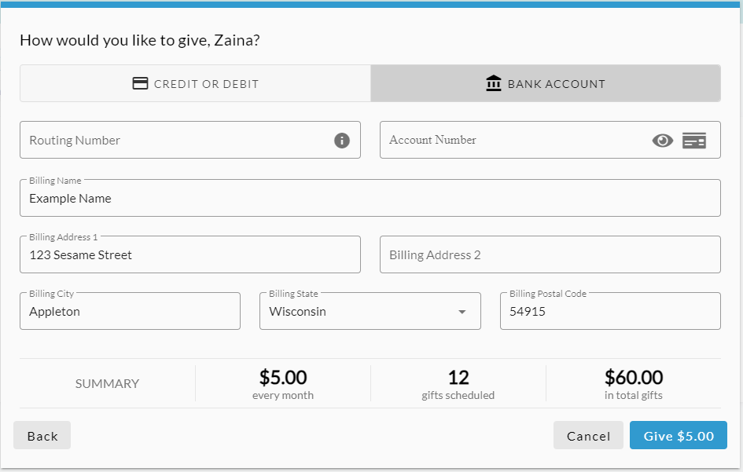
How to set up automatic giving
Fill out your card information, review everything, then click the blue “Give” button
Fill out your bank account information, review everything, then click the blue “Give” button

Slide 12
Need help or assistance?
Contact the front office staff at
Info@firstcongoappleton.org
Or call at
920.733.7393 OPT 2
Thank you!

